Slide 1
Machine Learning
Unit – 5 – [Part 3]
Hidden Markov Model

Slide 2
Hidden Markov Model (HMM)
You are sitting inside your house. You cannot see the weather outside (it's hidden), but you can see your friend’s mood (Happy or Sad).
Your friend’s mood depends on the weather:
If it’s Sunny, your friend is usually Happy.
If it’s Rainy, your friend is usually Sad.
So, by just seeing the mood, you try to guess the weather. This is what HMM does!

Slide 3
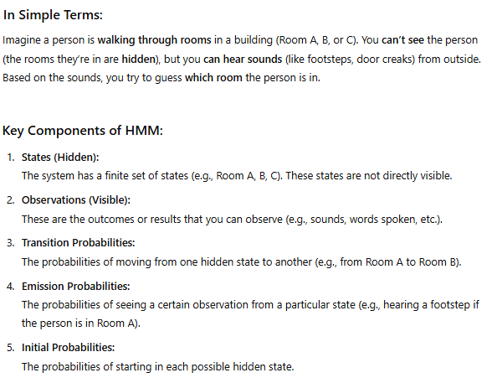

Slide 4
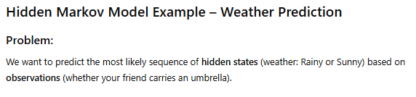
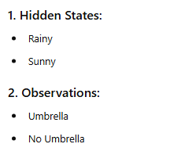
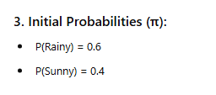

Slide 5
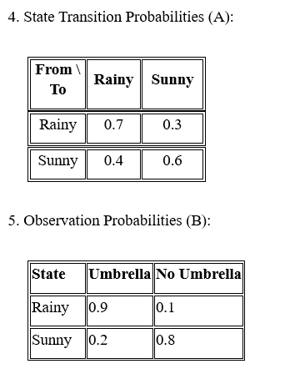

Slide 6
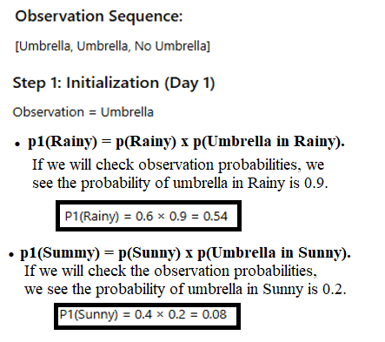
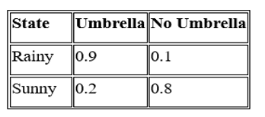

Slide 7
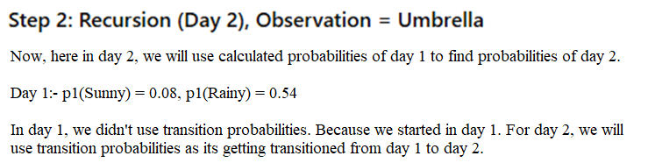

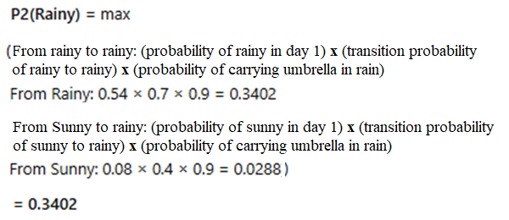
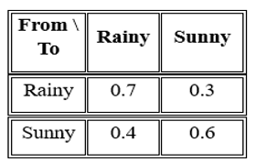
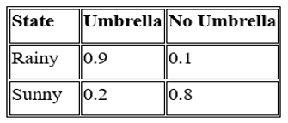

Slide 8
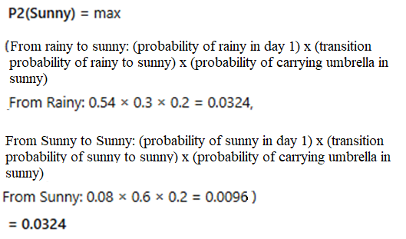
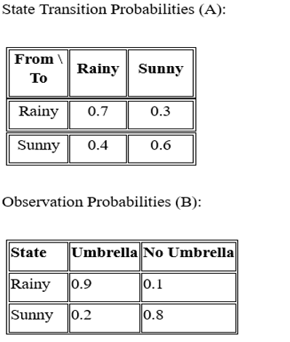
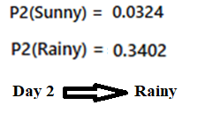

Slide 9
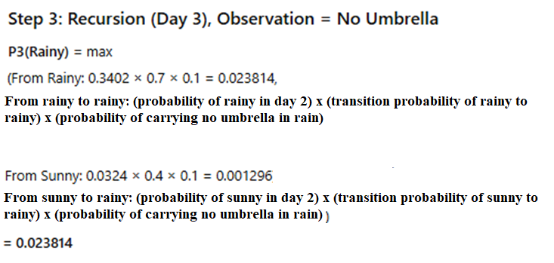

Slide 10
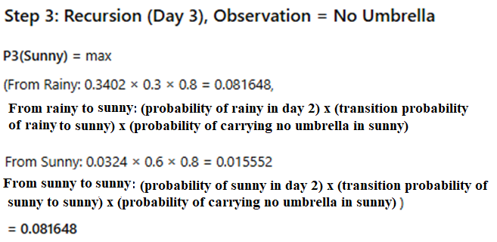
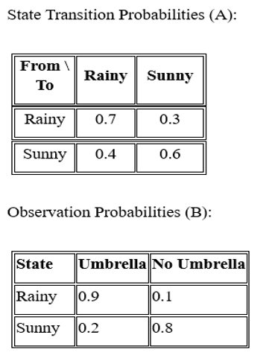
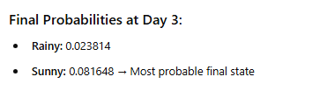

Slide 11
3 Basic problems of Hidden Markov Models (HMMs):-
1. Evaluation Problem – Is this observation sequence likely? We saw: Umbrella, Umbrella, No Umbrella We want to know: What is the total probability of this observation sequence happening, based on the model?
We are not trying to guess what the weather was. We are just checking.
2. Decoding Problem – What was the most likely weather?
Question: We saw: Umbrella, Umbrella, No Umbrella Now we want to know: What is the most likely sequence of weather conditions behind this?
This is exactly what you already solved:
Day 1 → Rainy, Day 2 → Rainy, Day 3 → Sunny
So the model says: The most likely weather behind this umbrella pattern is: Rainy → Rainy → Sunny
Used when: We want to guess the hidden reason behind the observations.

Slide 12
3. Learning Problem – Can we train the model from data?
Question: What if we only have a lot of umbrella data and don’t know the model rules?
Can we figure out:
What is the probability of Rainy to Sunny?
What is the probability of the person carrying Umbrella when it is Rainy.
This means we are teaching the model using only observed data.
Used when: We have data but don’t know the model probabilities.
Out of the 3 HMM problems:
The second one — Decoding Problem — is most commonly used in real-life applications.
That’s because in many real-world situations:
We only see the observations (like the umbrella)
But we want to guess the hidden states (like the weather)
And we already know or assume the model's probabilities
Some real-world examples:
In speech recognition, we hear the sound (observed), and want to guess the words (hidden)
In bioinformatics, we see DNA sequences (observed), and want to guess gene regions (hidden)
In finance, we observe prices, and want to estimate hidden market conditions

Slide 13
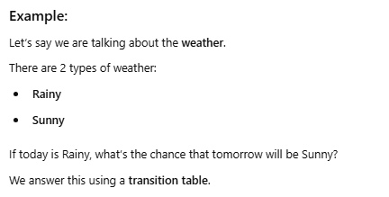
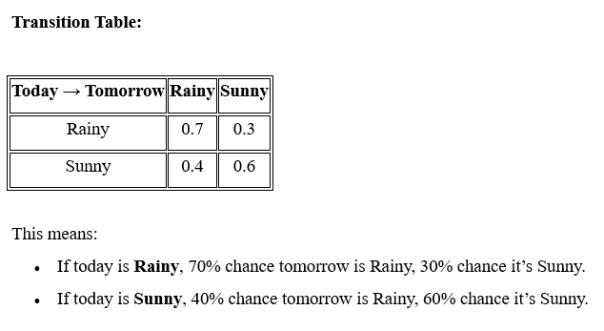
Discrete Markov Model

Slide 14
